Slide 1

Bayesian Decision Theory
An Introduction
By : Arya Rajiv Chaloli

Slide 2
ABSTRACT
ABSTRACT
Introduction
The Decision Rule
An example

Slide 3
INTRODUCTION
INTRODUCTION
Fundamental statistical approach
Uses probability of taking a decision and the costs that accompany such decisions.
It makes the assumption that the decision problem is posed in probabilistic terms, and that all of the relevant probability values are known.

Slide 4
PRIORI PROBABILITY
INTRODUCTION
Or prior
These prior probabilities reﬂect our prior knowledge of how likely we are to get a particular result before it actually appears. It might depend on various external factors
It is represented as P(ω_{i})

Slide 5
THE DECISION RULE – PART 1
THE DECISION RULE
Decide ω1 if P(ω1) >P(ω2); otherwise decide ω2.
In general, the probability of error is the smaller of P(ω1) and P(ω2)

Slide 6
THE DECISION RULE – PART 2
THE DECISION RULE
The probability of x being the feature value when the event w1 has occurred is expressed as p(x|ω1).
the likelihood of ωj with respect to x
The probability of w1 being the event when the feature value is x is expressed as p(ω1 | x).
posteriori probability or posterior

Slide 7
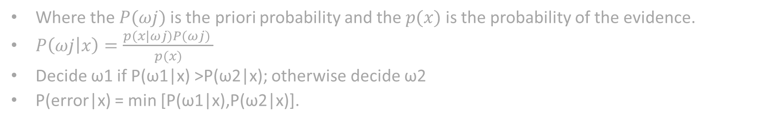
THE DECISION RULE – PART 2
THE DECISION RULE
Where the $P(ωj)$is the priori probability and the $p(x)$ is the probability of the evidence.
$P\left(ωj | x\right)=\frac{p(x|ωj)P(ωj) }{p(x)}$
Decide ω1 if P(ω1|x) >P(ω2|x); otherwise decide ω2
P(error|x) = min [P(ω1|x),P(ω2|x)].

Slide 8
THE DECISION RULE – PART 3
THE DECISION RULE
an expected loss is called a risk
R(αi|x) is called the conditional risk.
Whenever we encounter a particular observation x, we can minimize our expected loss by selecting the action that minimizes the conditional risk.

Slide 9
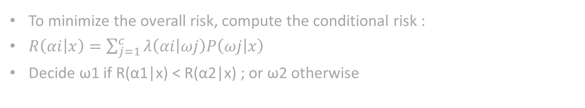
THE DECISION RULE – PART 3
THE DECISION RULE
To minimize the overall risk, compute the conditional risk :
$R\left(αi | x\right)=\sum_{j=1}^{c}{λ\left(αi | ωj\right)P\left(ωj | x\right) }$
Decide ω1 if R(α1|x) < R(α2|x) ; or ω2 otherwise

Slide 10
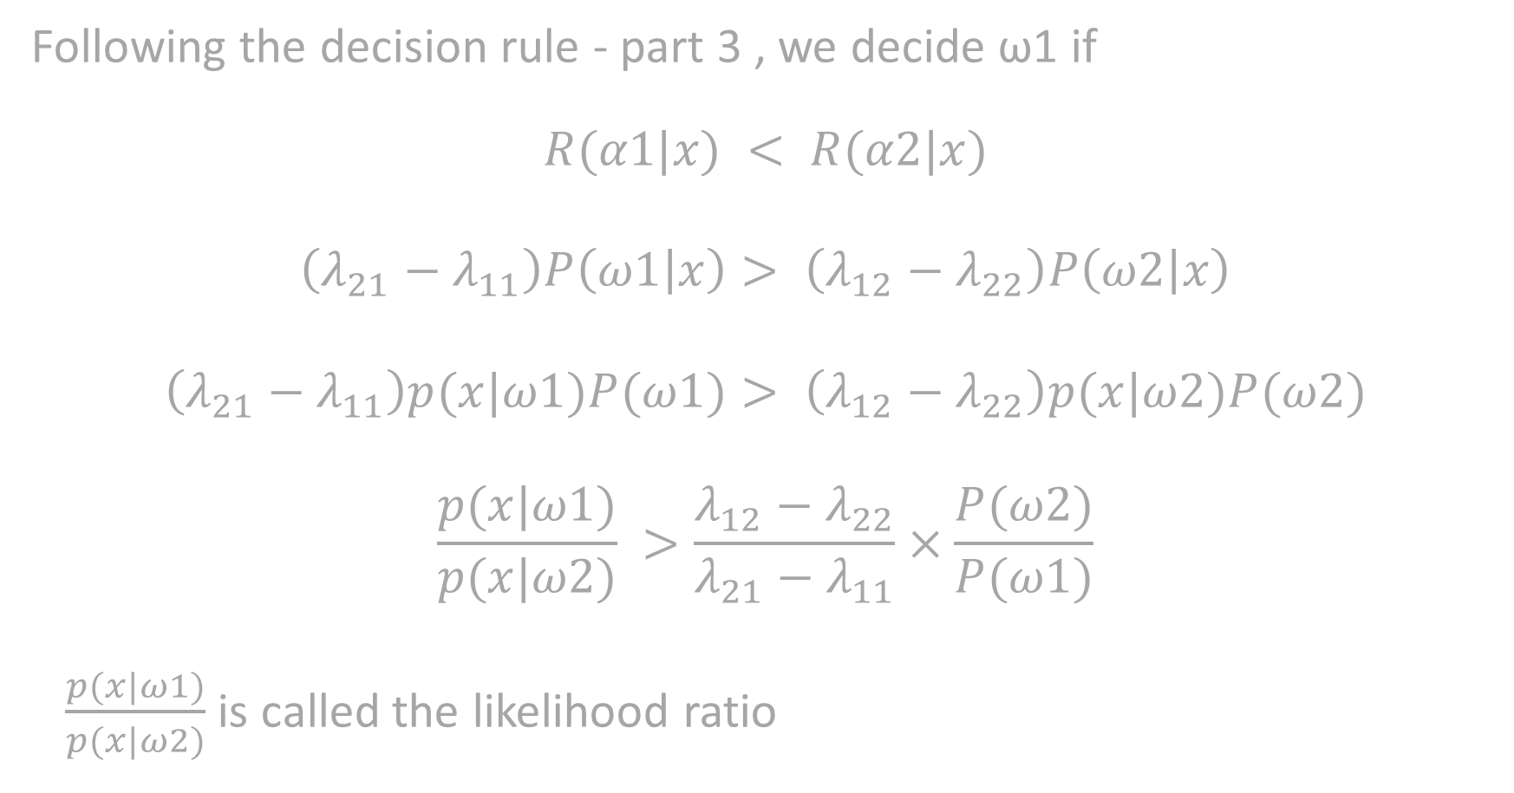
Following the decision rule - part 3 , we decide ω1 if
$$R(α1|x) < R(α2|x)$$
$$\left(λ_{21}−λ_{11}\right)P\left(ω1 | x\right)> \left(λ_{12}−λ_{22}\right)P\left(ω2 | x\right)$$
$$\left(λ_{21}−λ_{11}\right)p(x|ω1)P(ω1)> \left(λ_{12}−λ_{22}\right)p(x|ω2)P(ω2)$$
$$\frac{p(x|ω1)}{p(x|ω2)} >\frac{λ_{12}−λ_{22}}{λ_{21}−λ_{11}}×\frac{P(ω2)}{P(ω1)}$$
$\frac{p(x|ω1)}{p(x|ω2)}$ is called the likelihood ratio

Slide 11
BAYES RISK
THE DECISION RULE
Bayes risk is the minimum overall risk.
It is denoted by R*.
It is the best performance that can be achieved.
It is obtained from the Decision rule part 3

Slide 12
AN EXAMPLE
An Example
A student needs to achieve a decision on which courses to take, based only on his first lecture.
We define 3 categories of courses : good, fair, bad.
From his previous experience, we have the following data:

Slide 13
Quality of the course | Good | Fair | Bad
Probability (prior) | 0.2 | 0.4 | 0.4
Probability of the course being good fair or bad

Slide 14
Quality of the course | Good | Fair | Bad
Probability (prior) | 0.2 | 0.4 | 0.4
Probability of the course being good fair or bad
 | Good | Fair | Bad
Interesting | 0.8 | 0.5 | 0.1
Not interesting | 0.2 | 0.5 | 0.9
Probability of the first lecture of each kind of course to be either interesting or boring

Slide 15
Quality of the course | Good | Fair | Bad
Probability (prior) | 0.2 | 0.4 | 0.4
Probability of the course being good fair or bad
 | Good | Fair | Bad
Interesting | 0.8 | 0.5 | 0.1
Not interesting | 0.2 | 0.5 | 0.9
Probability of the first lecture of each kind of course to be either interesting or boring
 | Good | Fair | Bad
Taking the course | 0 | 5 | 10
Not taking the course | 20 | 5 | 0
The risks of either taking the course or dropping the course

Slide 16
Quality of the course | Good | Fair | Bad
Probability (prior) | 0.2 | 0.4 | 0.4
The probability of the first lecture to be interesting is:
Pr(int) = Pr(int|good)* Pr(good) +
Pr(int|fair)* Pr(fair) +
Pr(int|bad)* Pr(bad)
= 0.8*0.2+0.5*0.4+0.1*0.4
= 0.4
The probability that the first lecture is boring is :
Pr(bor) = 1 - P(int)
= 0.6
 | Good | Fair | Bad
Interesting | 0.8 | 0.5 | 0.1
Not interesting | 0.2 | 0.5 | 0.9
 | Good | Fair | Bad
Taking the course | 0 | 5 | 10
Not taking the course | 20 | 5 | 0

Slide 17
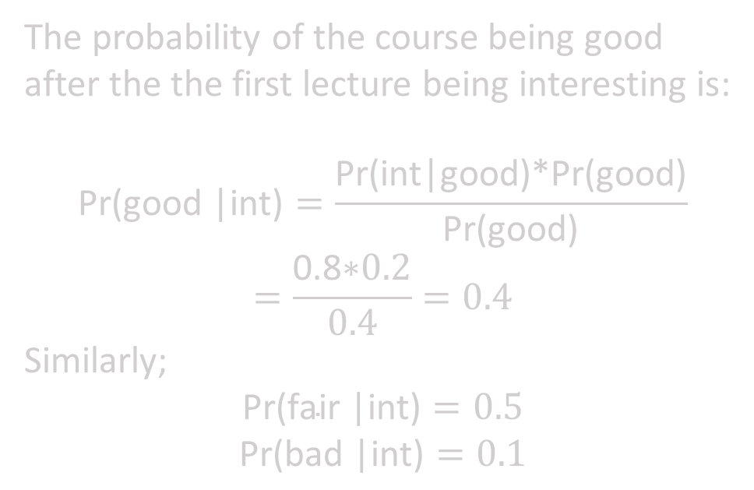
Quality of the course | Good | Fair | Bad
Probability (prior) | 0.2 | 0.4 | 0.4
The probability of the course being good after the the first lecture being interesting is:
$$\text{Pr}\text{(}\text{good}\text{ |}\text{int}\text{)}=\frac{\text{Pr}\text{(}\text{int}\text{|}\text{good}\text{)*}\text{Pr}\text{(}\text{good}\text{)}}{\text{Pr}\text{(}\text{good}\text{)}}$$
$$=\frac{\text{0.8}\text{∗}0.2}{0.4}=0.4$$
Similarly;
$$\text{Pr}\text{(}\text{fair}\text{ |}\text{int}\text{)}=0.5$$
$$\text{Pr}\text{(}\text{bad}\text{ |}\text{int}\text{)}=0.1$$
 | Good | Fair | Bad
Interesting | 0.8 | 0.5 | 0.1
Not interesting | 0.2 | 0.5 | 0.9
 | Good | Fair | Bad
Taking the course | 0 | 5 | 10
Not taking the course | 20 | 5 | 0

Slide 18
Quality of the course | Good | Fair | Bad
Probability (prior) | 0.2 | 0.4 | 0.4
The risk of taking an interesting course can be computed as follows:
R(take| int) = λ(take| good) Pr(good| int) + λ(take| fair) Pr(fair| int) + λ(take| bad) Pr(bad| int)
= 0.4*0 + 0.5*5 + 0.1*10
= 3.5
or drop it:
R(drop| int) = λ(drop| good) Pr(good| int) + λ(drop| fair) Pr(fair| int) + λ(drop| bad) Pr(bad| int)
= 0.4*20 + 0.5*5 + 0.1*0
= 10.5
 | Good | Fair | Bad
Interesting | 0.8 | 0.5 | 0.1
Not interesting | 0.2 | 0.5 | 0.9
 | Good | Fair | Bad
Taking the course | 0 | 5 | 10
Not taking the course | 20 | 5 | 0

Slide 19
THANK YOU

